Slide 1
what a seal´s smell can tell
- investigating the chemical basis of seal olfaction
Martin A. Stoffel
University of Bielefeld, Germany
Liverpool John Moores University, England

Slide 2
Inspiration
Antarctic fur seal females are actively choosing males that
are heterozygous and unrelated
- Hoffman et al. 2007, Nature
Australian sea lion mothers can identify their pups
by scent alone
- Pitcher et al. 2011, Biol Lett
Notes:
(1) Olfaction involved?

Slide 3
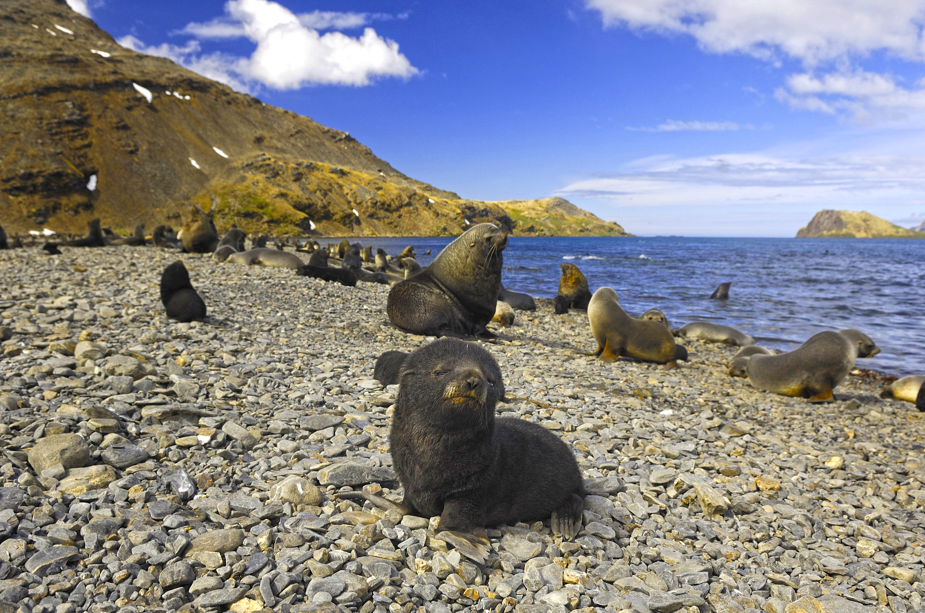
Image source: Oliver Krüger

Slide 4
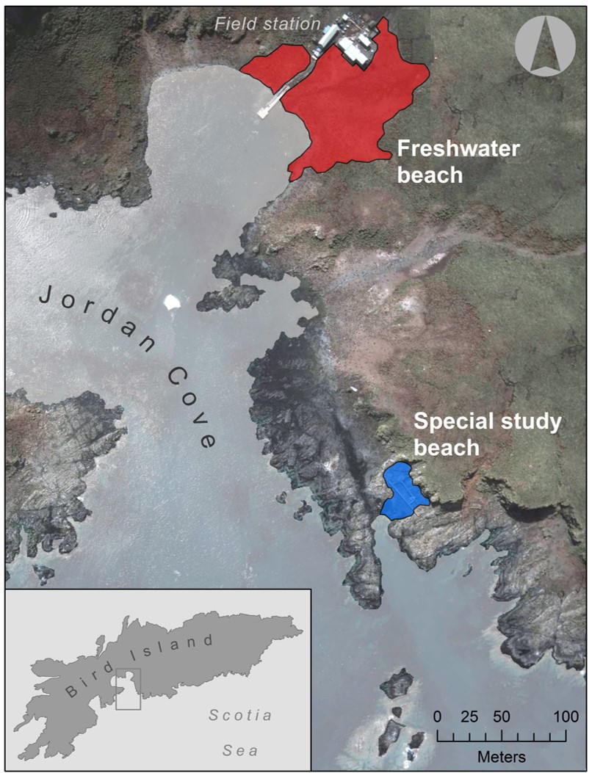
41 mum-pup pairs
Genetic samples
genotyping at 41 microsatellites
+
Scent samples
chemical analysis of
skin swabs
Notes:
For the scent samples, we used cotton wool to take skin swabs. The chemical composition of these scent samples was then analyzed in the lab.

Slide 5
Results

Slide 6
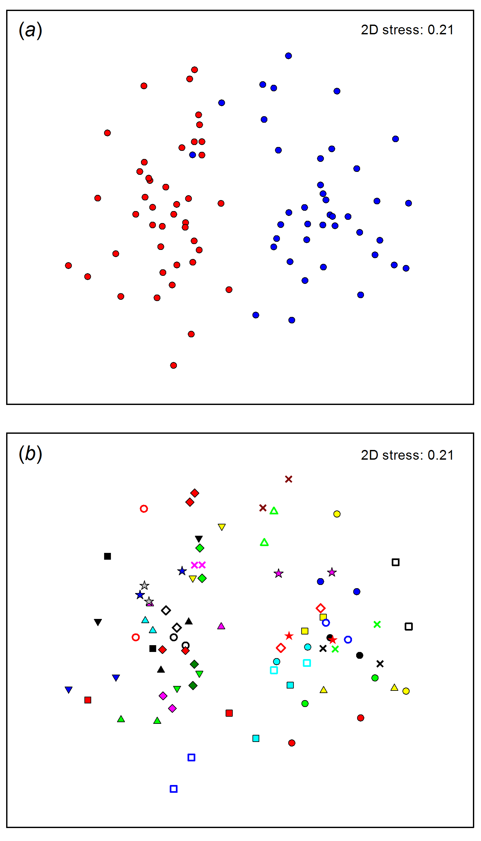
Chemical similarity among 82 individuals
Individuals with dissimilar skin chemicals
Individuals with similar skin chemicals
Stoffel et al. (2015) PNAS

Slide 7
(I)
Chemical similarity within colonies
Freshwater Beach
Special Study Beach
Stoffel et al. (2015) PNAS

Slide 8
(II)
Chemical similarity within mum-pup pairs
Chemical basis of olfactory mother-offspring recognition?
Stoffel et al. (2015) PNAS
Notes:
Self-referent phenotype matching?

Slide 9
What about the genetics…?

Slide 10
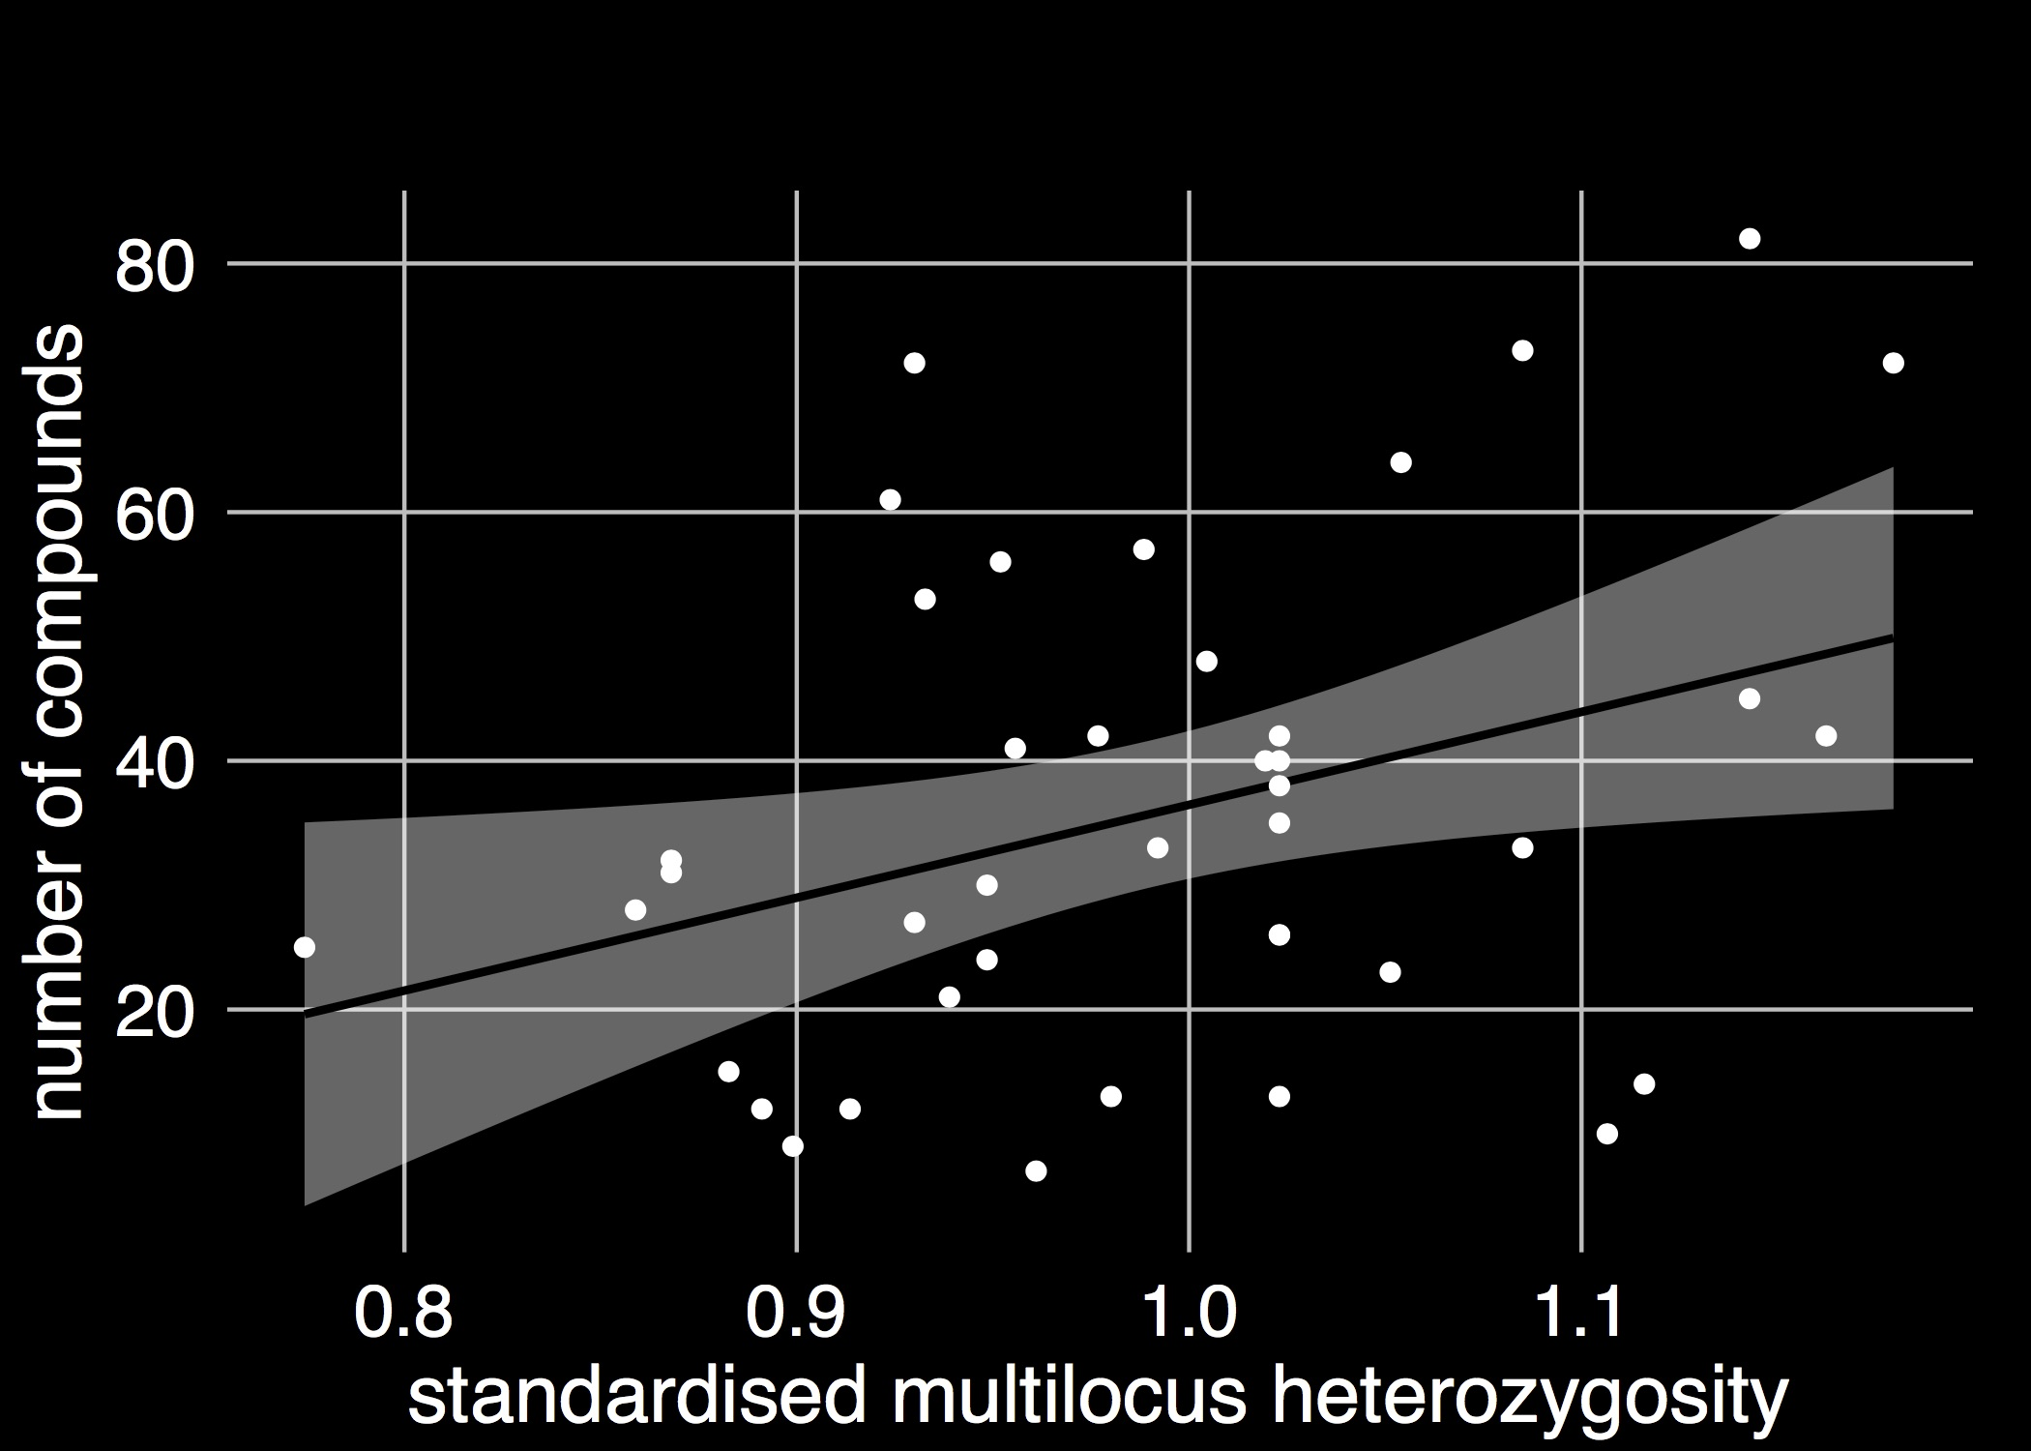
Chemical complexity correlates with
heterozygosity
(III)
r = 0.34
Olfactory signal for mate choice ?
Stoffel et al. (2015) PNAS

Slide 11
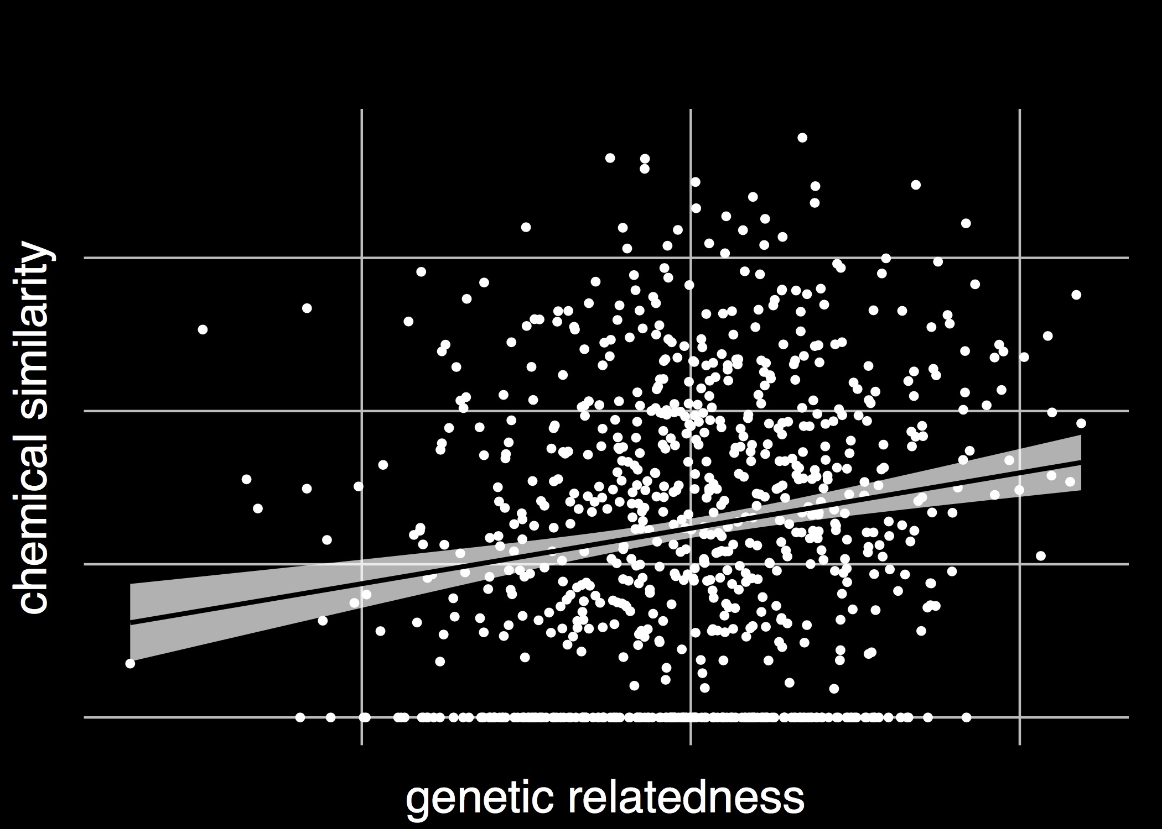
Chemical similarity at 10 compounds correlates with
genetic relatedness
(IV)
mantel r = 0.16
Olfactory signal for inbreeding avoidance ?
Stoffel et al. (2015) PNAS

Slide 12
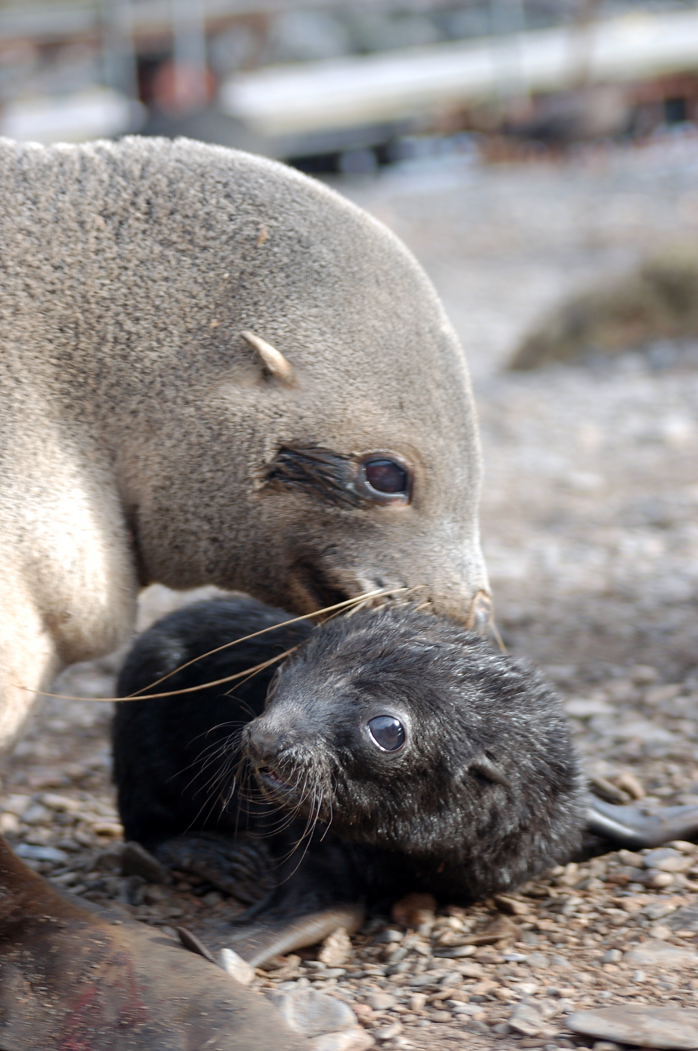
to sum up
Chemicals on the skin of Antarctic fur seals encode…
colony identity
mother-offspring similarity
heterozygosity
genetic relatedness

Slide 13
Thanks to all my collaborators!
Luke Eberhardt-Phillips,
Bielefeld University,
Behavioural Ecology
Barbara Caspers, Bielefeld University,
Olfactory Communication
Joe Hoffman,
Bielefeld University,
Molecular Ecology
Markus Baier,
Bielefeld University,
Chemical Ecology
Caroline Müller,
Bielefeld University,
Chemical Ecology
Athina Giannakara, Bielefeld University,
Evolutionary Biology
Jaume Forcada, British Antarctic Survey

